Slide 1
Social Survey
Individual Account vs Enterprise Account vs Admin Dashboard

Slide 2
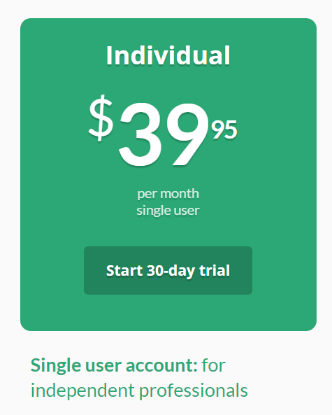
Individual Account

Slide 3
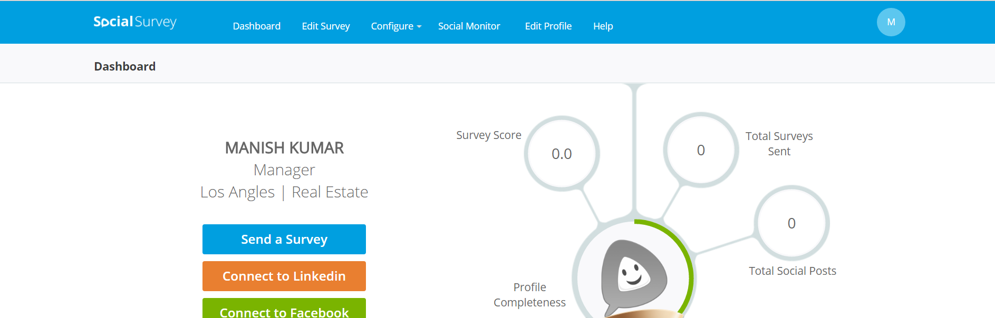
Individual Account Dashboard

Slide 4
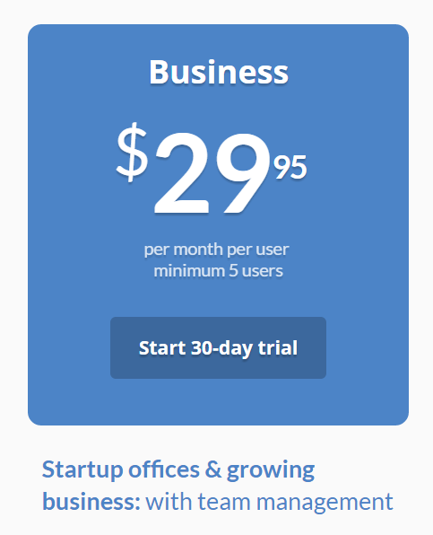
Enterprise/Business Account

Slide 5
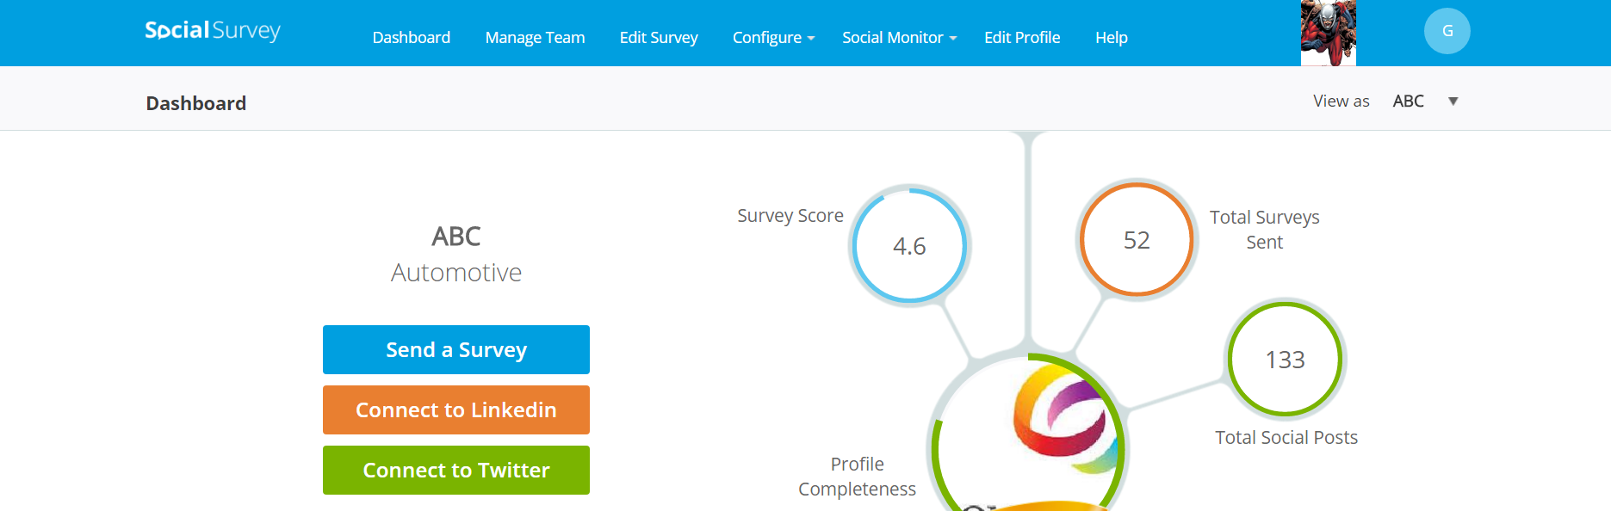
Enterprise Account Dashboard

Slide 6
Managed Team - Hierarchy Structure
Company
Regions
Offices
Users
Offices
Users
Users
Users

Slide 7
Admin Dashboard
Dashboard
Hierarchy
Send Invite
Abuse Reports
User Management
Reports
Batch

Slide 8
Types of Admins
Super Admin
Login with admin@socialsurvey.me
Super admin can create social survey admin
Social Survey Admin
SS admin is created by using User Management tab on Admin dashboard.
SS admin can be created by Super admin only.
User management tab will be hidden for SS admin.
Company Admin
Region Admin
Office Admin

Slide 9
Questions
?

Slide 10
Quiz
How many users can Individual account have?
How many maximum users can Enterprise account have?
Can users be directly under Company?
Can region be directly under office?

Slide 11
Answers
1
Any
Yes
No

